Slide 1
Competitive Programming
28 Oct. 2022
Andrei Novikov

Slide 2
Revise Homework - Overview
Book: “Competitive Programming 3”.
Algorithms:
Kruskal’s Algorithm
Tasks:
- UVa 00352 – The Seasonal War (Link)
- UVa 00657 – The Die is Cast (Link)

Slide 3
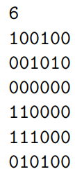
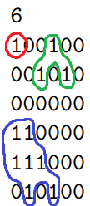
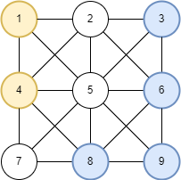
Revise Homework
UVa 00352 – The Seasonal War: Link
Solution: Link
Implicit graph
BFS or DFS

Slide 4
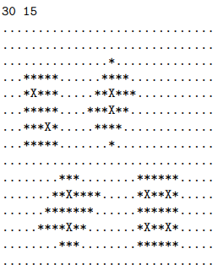
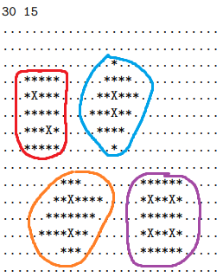
Revise Homework
UVa 00657 – The Die is Cast : Link
Solution: Link
Implicit graph
BFS or DFS if *
Store every X
BFS or DFS for every X to count value

Slide 5
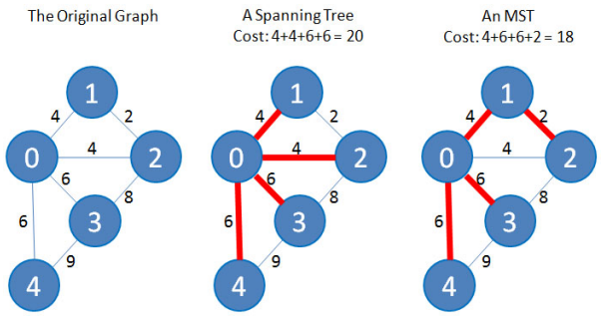
What is MST?
Minimum Spanning Tree (MST) is an edge-weighted undirected graph that connects all the vertices together, without any cycles and with the minimum possible total edge weight.
Illustration from the book CP3

Slide 6
Kruskal’s Algorithm
Kruskal’s Algorithm is a greedy algorithm. This algorithm is an example when greedy algorithm can find global minimum (not local minimum).
Sort edges by their weight
Is edge makes cycle?
Try to add edge to MST using Union ­Find Disjoint Sets
Until all edges are checked
No
Add edge to MST
Yes
Get next edge

Slide 7
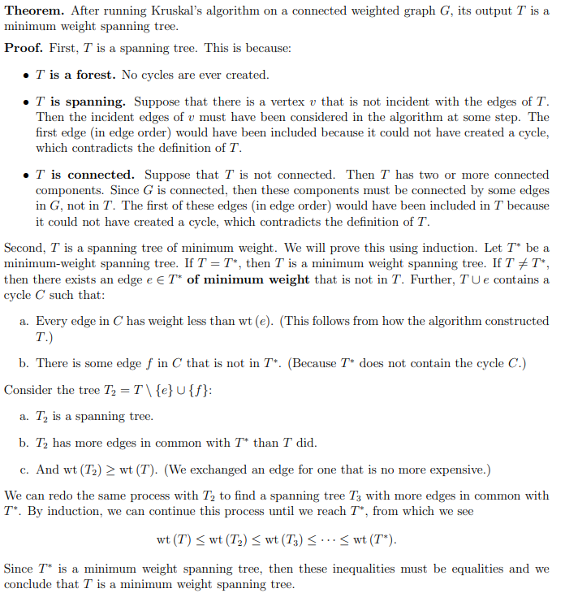
Kruskal’s Algorithm – Proof
Link to the theorem with proof: Link.

Slide 8
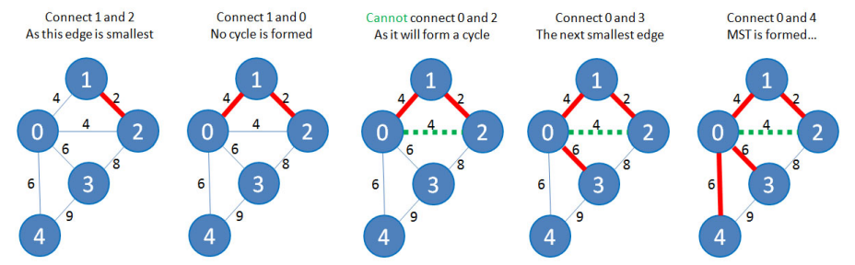
Kruskal’s Algorithm - Visualization
Illustration from the book CP3

Slide 9
Kruskal’s Algorithm - Disclaimer
Union-Find Disjoint Set (UFSD) are inefficiently implemented in C/C++, Java, C#, etc.
Operation to go via array of sets to find to which set an input point belong is very expensive operation O(n)!
O(sorting + trying to add each edge × cost of Union-Find operations) = O(E log E + E × (≈ 1)) = O(E log E) = O(E log V ²) = O(2 × E log V)
O(sorting + trying to add each edge × cost of Union-Find operations) = O(E log E + E × E) = O(E²)
Compare the complexity

Slide 10
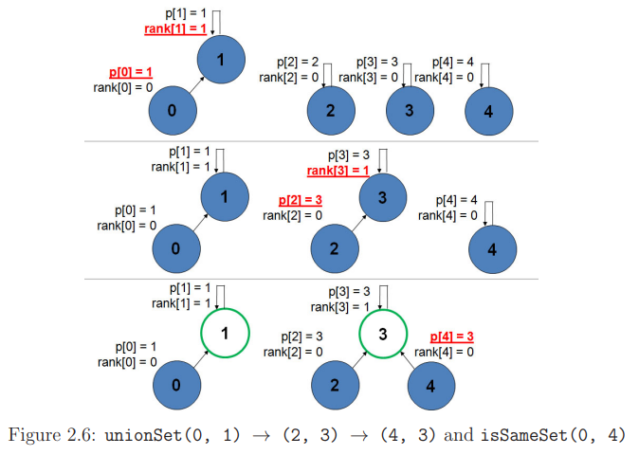
UFDS – Union Procedure
Illustration from the book CP3
Union-Find Disjoint Set consists:
Representers – p[0..N]
Height border – rank[0..N]
Union procedure:
Representer from tree with smallest rank point to representer from tree with highest rank.
Complexity: O(1)

Slide 11
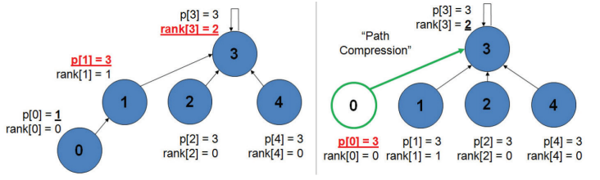
UFDS – Find Element Procedure
Naïve complexity to go through representer is O(N). But it can be improved.
When we call Find procedure, we need to update all representers during the search. Next calls will have complexity O(1).
Illustration from the book CP3

Slide 12
Quiz
Can you solve the MST problem faster than O(E log V ) if the input graph is guaranteed to have edge weights that lie between a small integer range of [0..100]? Is the potential speed-up significant?

Slide 13
Life Practice – Challenge #1
Topic: Graph
Resource: Leetcode (Competitive Programming 3)
0802 Find Eventual Safe States – Link

Slide 14
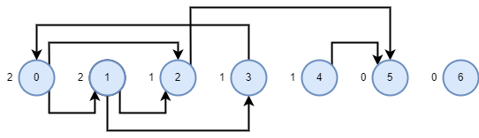

Life Practice – Challenge #1 – Solution
Reversed topological sort is an optimal solution.
Queue: [5, 6]
Result: [5, 6]

Slide 15
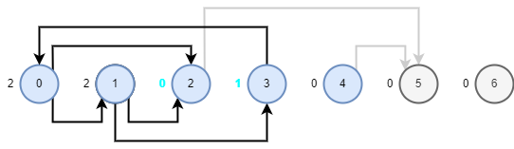


Life Practice – Challenge #1 – Solution
Reversed topological sort is an optimal solution.
Queue: [2, 4]
Result: [5, 6, 2, 4]

Slide 16
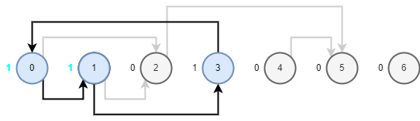
Life Practice – Challenge #1 – Solution
Reversed topological sort is an optimal solution.
Queue: []
Result: [5, 6, 2, 4]

Slide 17
Life Practice – Challenge #2
Topic: Counting Sort
Resource: Leetcode
0561 – Array Partition – Link

Slide 18
Home task
Competitive Programming 3.
Practice chapter 4.3.2 – Minimum Spanning Tree - Kruskal’s Algorithm.
UVa 00908 – Re-connecting Computer Sites - Link
UVa 01174 – IP-TV – Link
UVa 01208 – Oreon - Link

Slide 19




Where to Practice
LeetCode [link]
HackerRank [link]
Kattis [link]
TopCoder [link]
Other Resources

